Slide 1
RECALL
What were three significant events that happened in Germany during the ‘interwar years’?

Slide 2
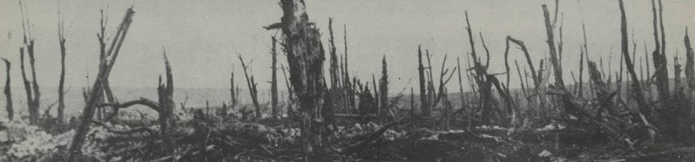
World War I

Slide 3
Nationalism-Devotion and loyalty to one’s country
Bosnia and Herzegovina demanded their independence from the Austro-Hungarian Empire
There was a competition in Europe for land, resources, and power. This competition led many countries to strengthen their armed forces (military)

Slide 4
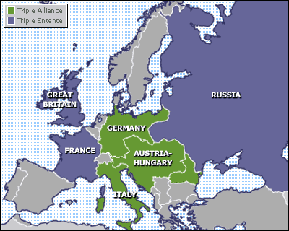
European Alliances Prior To WWI (1914)

Slide 5
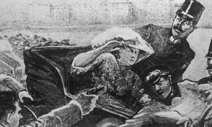
Assassination of Franz Ferdinand
The Archduke is assassinated by a Serbian on June 28, 1914.

Slide 6
New Alliances Form
Austria-Hungary declares war on Serbia after assassination.
Serbia turns to Russia for help and this forms new alliances in Europe.
Central Powers-Austria-Hungary and Germany
Allied Powers-Serbia, Russia, France and Great Britain

Slide 7
On the Battlefield
Germany sends troops into Belgium and France. The Allies stop the Germans just outside of Paris
Russia attacks Germany from the East, hoping to force Germany to fight on two sides of Europe and limiting their resources, which would hopefully end the war quickly.

Slide 8
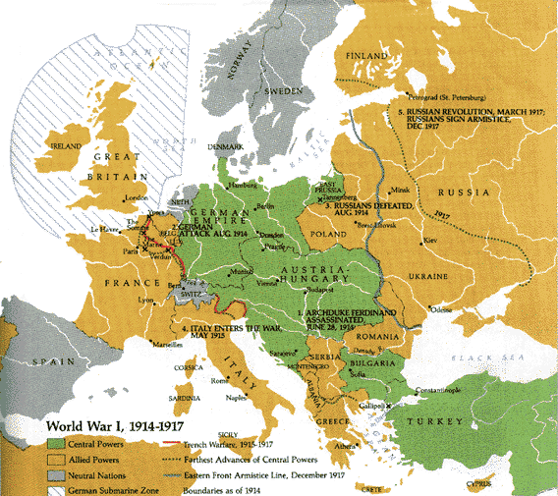

Slide 9
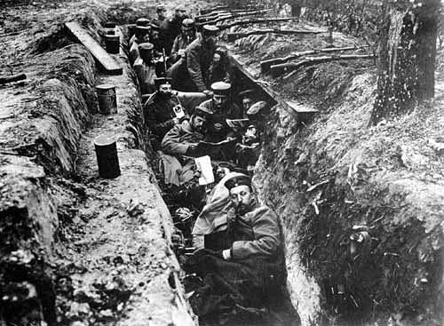
Trench Warfare
Trench Warfare-A style of fighting in which each side fights from deep trenches, or ditches, dug into the ground.

Slide 10
New Weapons
Machine Guns
Poison Gas
Tanks-Introduced by British
At Sea:
Britain used it’s Navy to block supplies from getting to Germany
Germany-used U-Boats (submarines) to try to and sink ships bringing supplies to Britain.

Slide 11
The End of the War
Stalemate between Allied forces (Britain, France and Russia) and Central Powers (Germany, Austia-Hungary) on the Eastern Front.
In 1917 America enters the war after repeated attacks on American ships by German U Boats
America’s help to the Allies gave them a fresh advantage.
Russia pulls out of the war soon after America enters
In the fall of 1918 the Central Powers surrender.

Slide 12
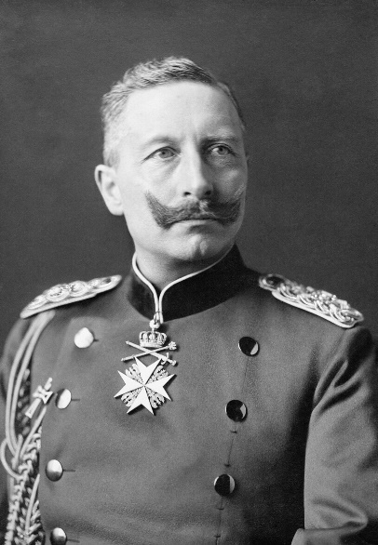
Ending the War
On condition of the armistice, Kaiser Wilhelm II forced to abdicate.
  Fled into exile 10th November 1918 (1 day before end of WW1)
Weimar Republic formed 9th November 1918
  Weimar Constitution
  Social Democrats in charge

Slide 13
Treaty of Versailles
US and President Woodrow Wilson called for a just peace-fair not harsh or causing anger in the losing countries.
Other Allied leaders (France and Britain) wanted to punish Germany for their actions.

Slide 14
Treaty of Versailles
Under the Treaty Germany had to:
Accept blame for starting the war
Drastically reduce the size of it’s army
Give up their overseas colonies
Pay Billions of Dollars for the damages caused by the war

Slide 15
Key question
What impact did WW1 have on Germany? (how did it change Germany?)
  What impact did the Treaty of Versailles have on Germany?
  Consider the terms of the Treaty, the ‘Stab in the Back’ myth, German people’s reactions.
Find the definition for the following key words:
  Reichstag
  Kaiser
  Abdicate
  Allies
  Exile
I will come and check your reading/revision booklet while you are working

